Slide 1
a fighter for the authority of the Bible and “creator” of the
Hebrew New Testament
Franz Delitzsch

Slide 2
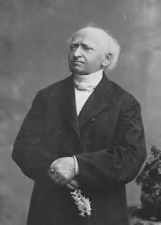
Franz Julius Delitzsch 1813-1890

Slide 3
Franz Delitzsch
Born in Leipzig, February 23rd, 1813
Originating from a poor family
Came to faith due to the testimony of a messianic Jew
In-depth studies over his entire life

Slide 4

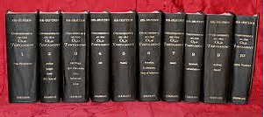

Franz Delitzsch, Professor of Theology

Slide 5
Franz Delitzsch
Edited the New Testament in Hebrew in1877
Worked on the translation for 51 years

Slide 6
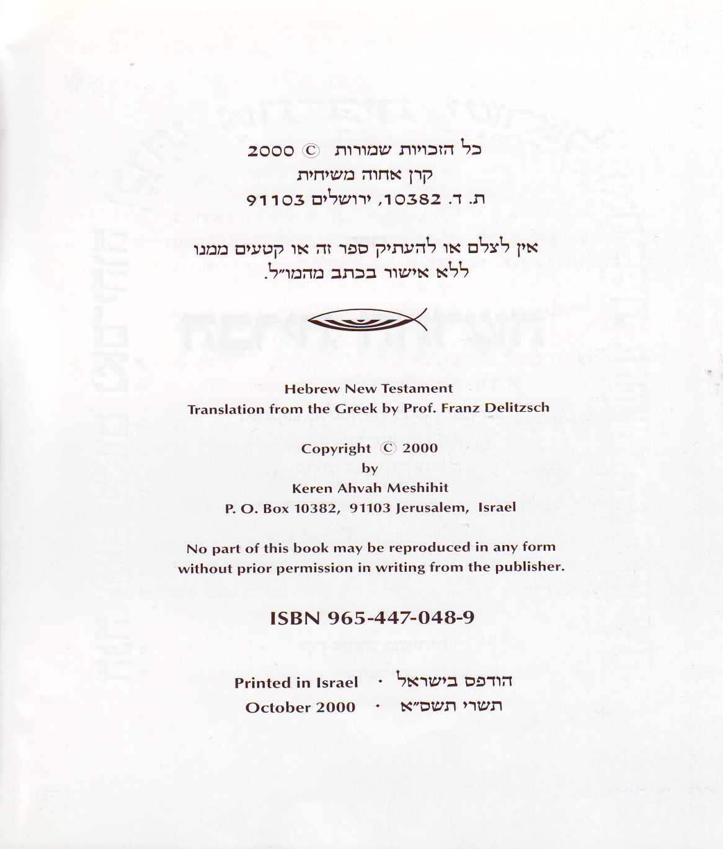
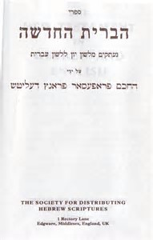

Slide 7
Franz Delitzsch
Launch of the Centralverein in 1871
Launch of „Institutum Judaicum“ (later „Delitzschianum“) in1886
Publisher of „Seeds of Hope“ between 1874 and 1888

Slide 8
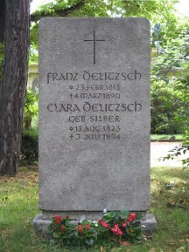
Franz Delitzsch buried in Leipzig 1890

Slide 9
Franz Delitzsch
A quote: „The anchor of our hope is the prophetic-apostolic word that is about to be fulfilled.“

